Slide 1
Google Play Store Analysis
By
K. Shanmugapriya

Slide 2
Business problem
Challenges
To Identify the targeted customers
How to improve the customer experience through the app and monetize it

Slide 3
Goal
To increase the app subscriber base
As a DA, I wanted to help the developer by analyzing the past data which affects the number of downloads, ratings, and revenue.

Slide 4
What do we Propose?
An Interactive dashboard gives a clear idea of which factors affect the app ratings and revenue from it.
Give a clear picture of which measures we need to make to improve the business

Slide 5
Google PlayStore Dataset
This dataset contains information on App categories, Rating, Rating count,
No.of.Installs, In-app purchases, Ad support, and so on from September 2009
to May 2020

Slide 6
Solution
Flow of the Solution Dashboard
Data Collection
Data Preparation
Data Storage
Data Analysis

Slide 7
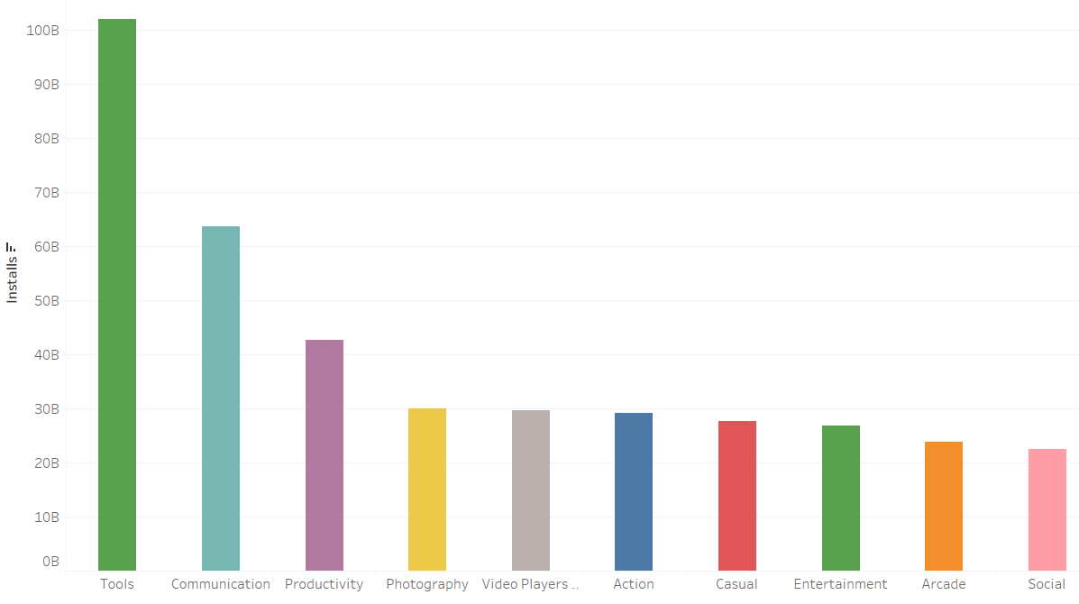
Top 10 Categories Installed

Slide 8
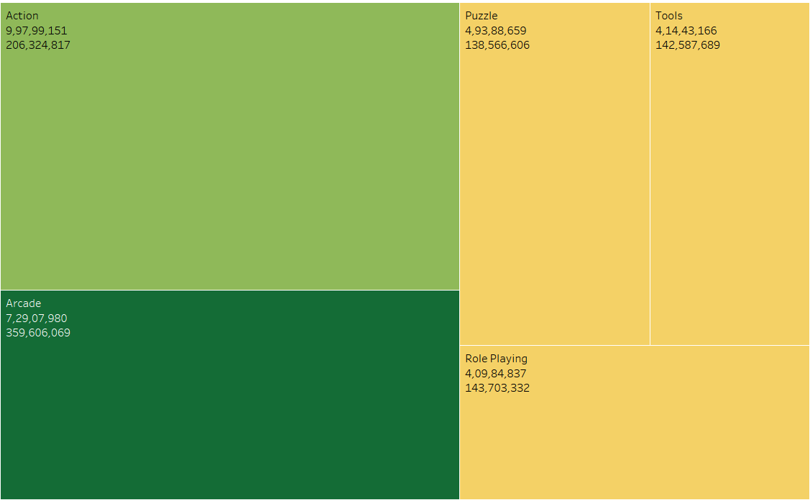
Top Revenue by Categories

Slide 9
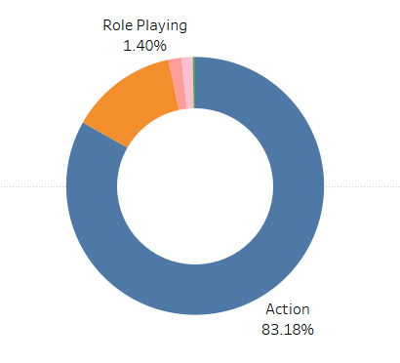
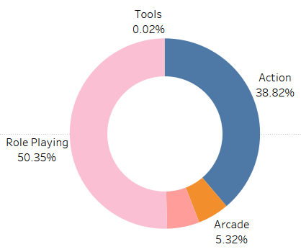
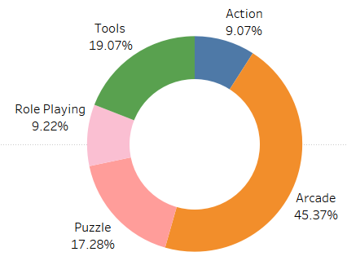
Revenue By Customer Group
Teen
Adults
Everyone

Slide 10
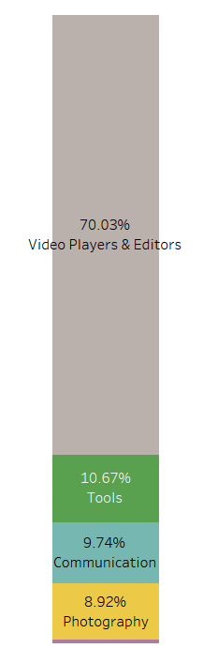
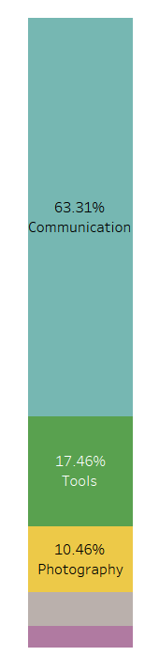
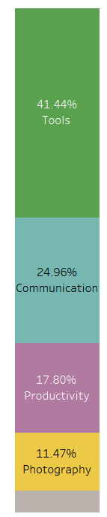
Installs By Customer Group
Teen
Adults
Everyone

Slide 11
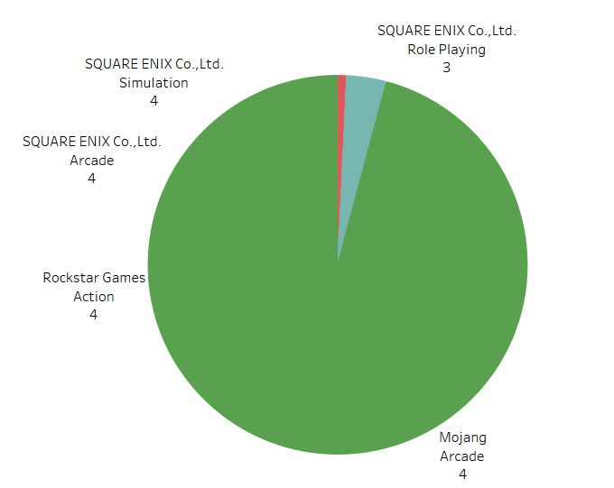
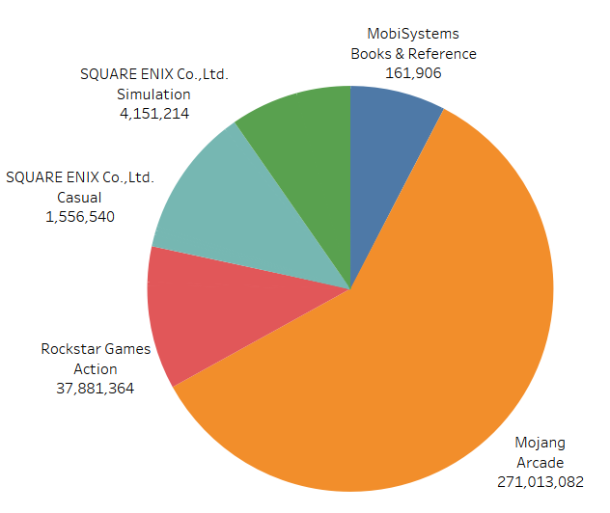
Top Developer Revenue
Top Revenue Developer
Rating of Revenue Developer

Slide 12
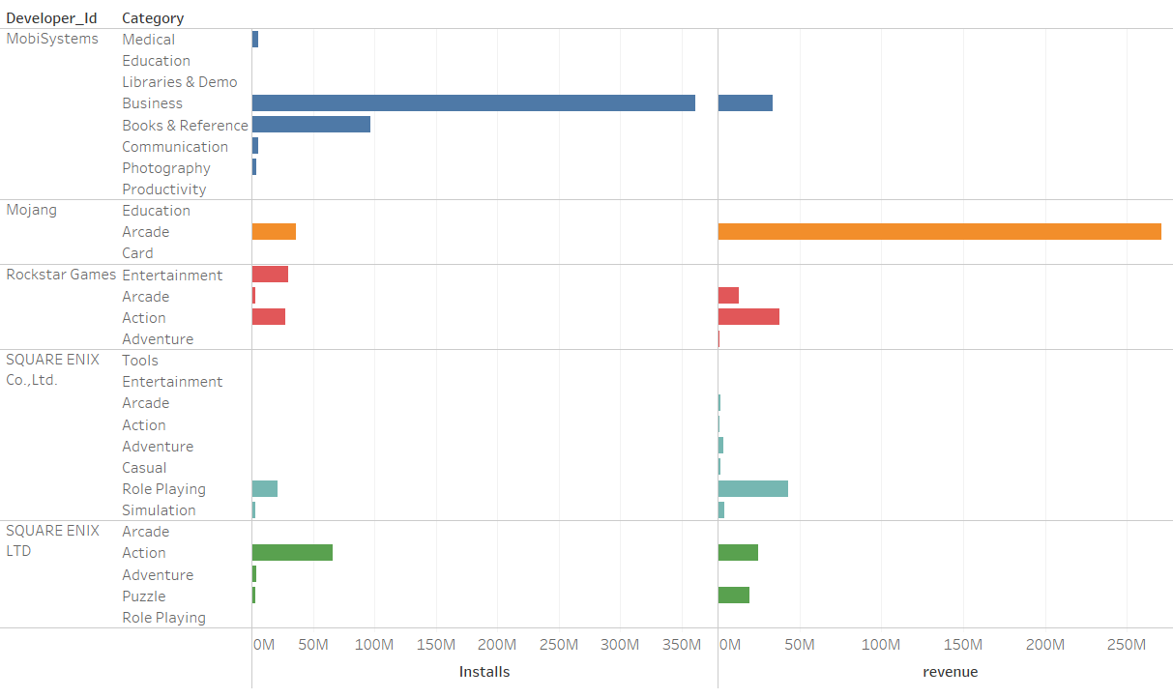
Installs vs Revenue

Slide 13
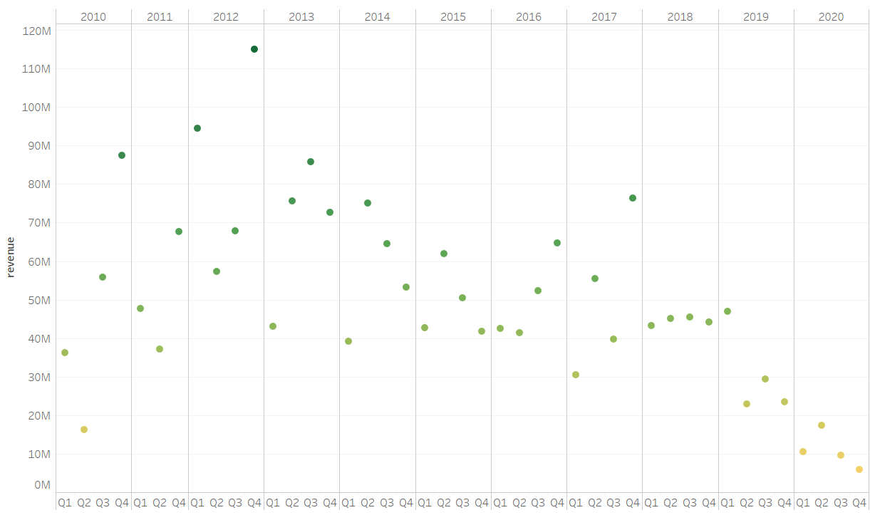
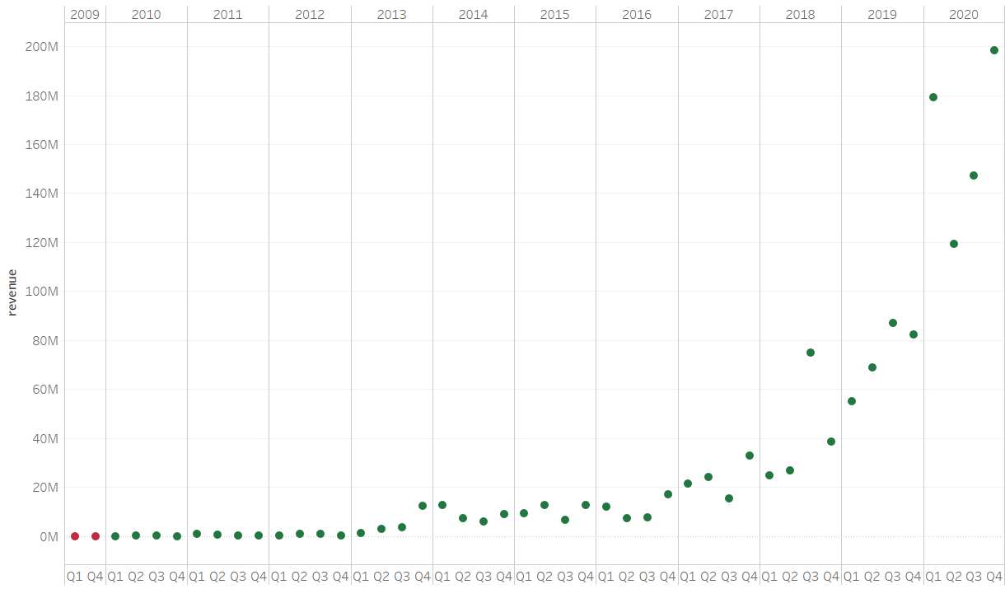
Revenue Growth
Revenue Growth After App Release
Revenue Growth After App Update

Slide 14
Conclusion
Maximum revenue generated by categories Arcade
More revenue generated by customer group
Teen – Role Playing
Adults – Action
Everyone – Arcade
Most Installed apps by customer group
Teen –Video Players & Editors
Adults – Communication
Everyone – Tools
Developer ID Mojang got the highest revenue with 1 app in the arcade category
Even though Mojang has the highest revenue, it got the Rating as 4
Second most revenue-generating developers release the apps in a different category, it’s good to try different things.
Apps that are installed more have less Revenue, So we can release the paid version.
Developing the app is good but updating the features is great for our revenue

Slide 15


